Slide 1


Lecture No. 10
Philosophy of Freedom

Slide 2
1. The Concept of Freedom in the History of Philosophy.

Slide 3
One of the important philosophical problems is the problem of FREEDOM. After all, without it, a person cannot practically realize the intended goals, his abilities. The need for freedom is deeply embedded in man, it is immanent in any kind of his activity, it is connected with the very essence of the nature of man as a creature who freely chooses between various alternatives. In principle, we cannot evade a choice, because by rejecting one thing, we (whether we want it or not) we choose another, by rejecting another, we choose a third, etc. Without the choice of alternatives and goal-setting, there can be no person. In this regard, the Hungarian philosopher of the 20th century, D. Lukács, defined man as a "choosing being."
The human in man is formed in the process of his increasing acquisition of spiritual freedom.
At the same time, he does not possess complete, once and for all acquired freedom, but only a certain "measure" of it, which is a dependent and variable value. "The measure of freedom," wrote the Italian philosopher A. Gramsci, "is included in the concept of man."
In the most general form, freedom is the ability of a person to be active in accordance with his desires and interests
There are different degrees of freedom. Freedom consists in the ability to do everything that does not harm another. The exercise of the natural rights of each person is limited by the limits that ensure that other members of society enjoy the same rights. The possibilities of freedom are commensurate with the degree of responsibility. The wider the capabilities of a person, the more significant the positive and negative consequences of his choice.

Slide 4
Philosophical views on the concept of freedom have differed in different historical epochs. In the times of antiquity (Ancient Greece), the prevailing position was that freedom was recognized as the highest virtue, good, and therefore was considered the prerogative of the gods, who did not have earthly passions. Whereas man, being in the grip of his passions and the need to fight external threats, was forced to deviate from the path of good. Even in the conditions of life of slaveholding states, there were those who believed that by nature all people are born equally free. Although the opposite views were held, for example, by Aristotle, who draws a clear distinction between a free man and a slave:
"Nature is arranged in such a way that the very physical organization of free people differs from the physical organization of the slave part of society: slaves have a powerful body, suitable for performing the necessary physical work; on the contrary, free people are not capable of performing this kind of work, but they are suitable for political life, but it often happens that free people are free not in their physical, but only in their intellectual organization. And although the beauty of the soul is not so easy to grasp with the eye as the beauty of the body, in any case it remains obvious that some people are free by nature, while others are slaves, and it is both useful and just for the latter to be slaves" (Politics).

Slide 5
The problem of freedom in the Middle Ages and in the period of the Renaissance is posed and solved within the framework of the Christian idea of predestination and freedom of will.
For example, Erasmus of Rotterdam noted: "Free will is the name of God. Therefore, the human will is a tiny part of the divine grace that flows freely upon man. In fact, the human will is his illusion, it is his pride, which makes a person do evil; human nature is blind, it does not know its own powers, and, finally, in its pride, it believes that it can do everything and knows everything."

Slide 6
In the era of the Modern Age and the XVIII century, such a contradictory concept as "freedom" has acquired a new interpretation on the part of thinkers. It began to be considered as a law of nature, human nature, world spirit, society, and transcendental values. The right of a person to be equal to another, to be free in his decisions and actions was declared, measures were developed to ensure civil and political freedoms. Thus, the philosophy of the Modern Age departs from the canons of religion, so freedom is no longer a grace given by God, but an integral part (right) of every person.
Now freedom is a human activity expressed in the choice of action or inaction, limited by the norms of the law.
Philosophers of the new era face such problems of freedom as: freedom of choice, freedom of action, freedom and responsibility and, of course, freedom of will.

Slide 7
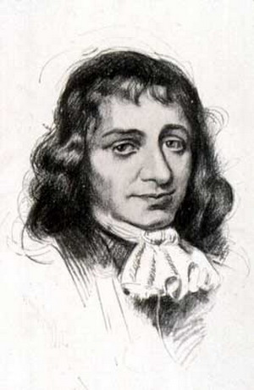
Understanding man and people as a part of Nature, subject to its laws, Spinoza believed that man should humbly endure everything that falls to his lot, since he is unable to change it. "Not to ridicule human actions, not to be upset by them and not to curse them, but to understand.“
Man is the more free the more he is guided by reason, which cognizes the necessity of nature.
Thus Freedom is a realized necessity.

Slide 8
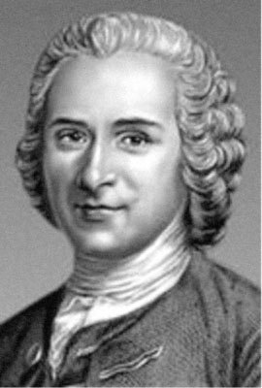
Freedom is democracy, the equality of all before the law.
Rousseau considered spiritual life, enlightenment, mind, and consciousness to be decisive in the development of society. He insisted on the need to replace social inequality with a new state of equality, different from the previous one.

Slide 9
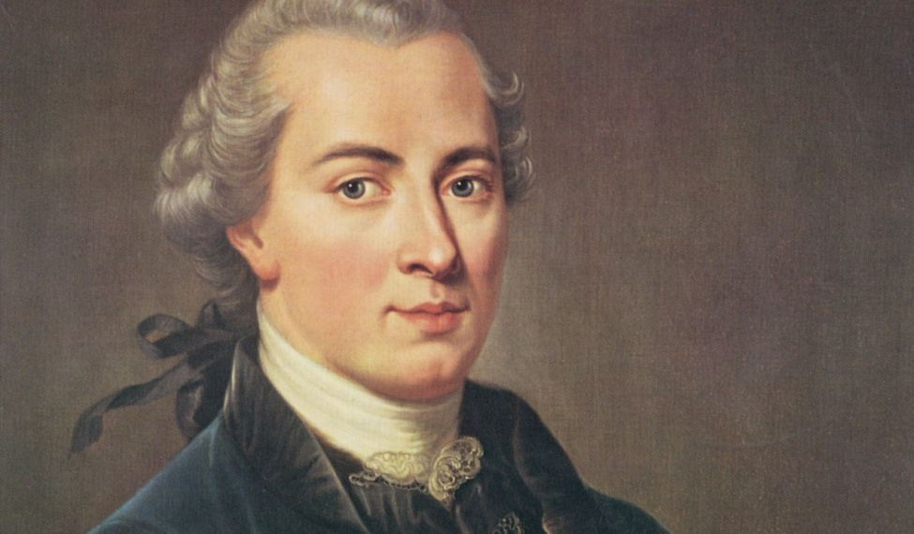
Kant understands freedom as the independence of a person from the coercive arbitrariness of anyone.
Since freedom can be compatible with the freedom of every other person in accordance with the universal moral law, it must be regarded as the only original right inherent in every human being by virtue of his or her membership in the human race.

Slide 10
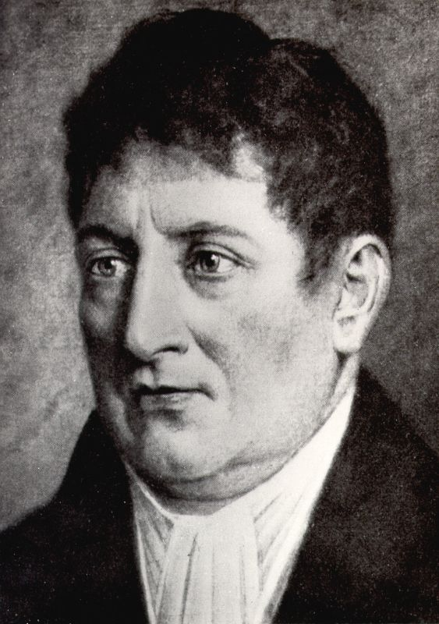
The highest principle for I. Fichte is absolute freedom, which a person must realize in his activity.
Man is absolutely free in his activity, but must act in accordance with the principle of duty.

Slide 11
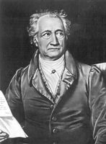
Hegel's free will means nothing more than the ability to make decisions with knowledge.
Freedom, therefore, consists in domination over ourselves and over external nature, based on knowledge of the necessities of nature.

Slide 12
In the philosophy of the 19th and 20th centuries, there is a distinction between negative freedom (freedom "from") and positive freedom (freedom "for"). Such an approach to the characterization of the concept of "freedom" was first introduced by the German philosopher and sociologist Erich Fromm, and then it was adopted by representatives of the positivist trend in philosophy.
Negative freedom is "freedom from", a freedom that denies, destroys dependence "on" – on the forces of nature.
Under these conditions, man is faced with a choice: either to get rid of this freedom with the help of a new dependence, a new subordination, or to grow to positive freedom.
Positive freedom is "freedom for", which gives the opportunity for the full realization of intellectual and emotional abilities,
requiring this realization from the individual, freedom based on the uniqueness and individuality of each person

Slide 13
The other direction, existentialism, is characterized by the understanding of freedom as the greatest human value, and at the same time as a heavy burden, a heavy cross, since freedom of choice and decision-making are inevitably associated with constant risk and personal responsibility. To be free is much more difficult than to be a slave, a conformist, an indifferent opportunist. Therefore, not everyone wants to be truly free, but everyone wants to be known, to appear free, preferring to imitate freedom, dissolving in the mass, in the crowd, in order to shift the burden of personal responsibility to others.
"The main feature of our time," wrote K. Jaspers, "is that, although everyone craves freedom, many cannot stand freedom. They strive for a place where, in the name of freedom, they are freed from freedom."

Slide 14
Existentialism also proceeds from the fact that man is "doomed" to freedom, since the transformation of the world is a way of human existence and thus creates an objective condition for freedom. The emergence of the idea of freedom and social thought occurs only when consciousness sets in. First of all, it is an awareness of the deep fact that the paths of man and the paths of nature are different. Then there is the realization that there is a variety of goals and ways to achieve them. Therefore, a person who lives and does not know that it is possible to live differently exists, as it were, outside the problem of freedom and necessity. The problem arises when he learns about the existence of other life paths and begins to evaluate and choose them. Many thinkers consider freedom as the foundation of human dignity and also as a responsibility that burdens us.
(I. Kant, F. Dostoevsky, N. Berdyaev, M. Heidegger, etc.).

Slide 15
Thus, the most obvious problems of freedom can be identified:
the problem of understanding and awareness of freedom; the problem of a false understanding of freedom; the problem of the essence of freedom; the problem of the boundaries of freedom; the problem of ways to achieve true freedom; the problem of freedom of choice; the problem of freedom of action; the problem of free will; the problem of freedom and necessity; the problem of freedom and responsibility; the problem of moral choice; the problem of absolute freedom, etc

Slide 16
2. Types of freedoms, their historical development

Slide 17
The life activity of a person takes place in various spheres of his social and individual existence: political, economic, spiritual, moral, aesthetic, intimate, etc. Accordingly, the category of freedom reveals various facets, manifests itself as
economic freedom, political freedom, spiritual freedom, freedom of speech freedom of creativity, personal freedom, freedom of choice, Freedom of faith
In other words, the versatility and variability of social relations determine the variety of manifestations of freedom, its various types.

Slide 18
Civil freedom is freedom as a public person, it is a freedom that does not limit the freedom of others.
Political freedom is freedom from political despotism over a person.
Religious freedom is God's choice.
Spiritual freedom is the power of a person over his egoism, his passions, sinful feelings, for this word has the meaning of the Spirit as pure, good, and unconstrained.
Moral freedom is a choice between good and evil.
Economic freedom is the freedom to dispose of all types of one's property

Slide 19
True freedom is the aspiration of the human spirit to freedom itself. Natural freedom is the cognition of natural necessity and action in accordance with the known natural laws. Freedom of action is the ability to act in accordance with the conscious choice of the body that corresponds to the purpose of this desire. Freedom of choice is the ability of a person or a process to choose an option and implement (ensure) the outcome of an event. Freedom of will is the ability of a person to make a choice regardless of certain circumstances. Absolute freedom is the flow of events in such a way that the will of each actor in these events is not subjected to violence by the will of other actors or circumstances. In relation to a person, external and internal freedom are distinguished. Internal freedom is spiritual, ideological freedom, freedom of reason, liberation, harmony of soul and mind, freedom associated with one's Self.
External freedom is material freedom, freedom of action, freedom associated with the interaction of the external world.

Slide 20
Modern philosophy comprehends the problem of freedom on the part of the individual as the inner freedom of man. As G. Hegel noted: "a slave who has realized his slavery is no longer a slave" (already a free man).
In real life, a person often finds himself in situations where a choice that outwardly seems free (even if it is made on the basis of cognition and consideration of objective necessity), in fact, on closer examination, turns out to be not free, since it was made reluctantly, i.e., contrary to the inner convictions of the individual, his conscience, and personal interests. Truly free choice is a choice, the content of which is not something external and alien to man, but corresponds to his inner desires. Freedom is felt by the individual primarily as a personal feeling, as a subjective phenomenon consisting in the ability to make a choice independently. At the next stages, freedom of choice turns into freedom of decision, and then into freedom of action, freedom of creativity and self-expression. In the process of goal-setting practical activity, the freedom of the individual unfolds in various aspects, passes through various phases, from the individual's subjective (internal) awareness of his freedom, the possibility of acting in one way or another, to its objective realization (if there are conditions for this). We are talking about the subjective-moral, subjective-active aspect of freedom, freedom as an internal action of the individual, as the possibility of autonomous choice of a certain goal and the means of achieving it, a conscious desire for its realization. Inner freedom is a specifically human selective, creative activity of consciousness, intuition, the unconscious, will, and moral forces, which, as a result of the internal struggle of motives, are mobilized for independent choice, decision-making, and its implementation.

Slide 21
It is important to note that the inner world of a person, the possibilities of free choice and self-expression are formed not only by rational and logical knowledge, but also by non-rational (emotional-figurative, associative, intuitive, etc.). Freedom is not always the result of a rationally balanced, analytically thought-out choice. In real life activity, it is a manifestation of the entire spectrum of a person's subjectivity, the result of his integral, i.e., both rational and emotional-sensual, perception of the world and expression of will. One of the manifestations of human freedom is the ability to govern oneself. The expression "domination over ourselves" (F. Engels) is often interpreted one-sidedly, as the domination of reason over feelings, as the ability to suppress one's feelings and passions. However, the task is not to suppress feelings, but to make feelings genuinely human, as close as possible to their socially active nature. Life shows that no external conditions, no matter how favorable they may be for a person, can’t by themselves lead to the realization of his abilities. This also requires personal aspiration, will, inner uninhibitedness, and spiritual freedom of this individual. A negative influence on the spiritual freedom of many people is exerted by various kinds of inferiority complexes, prejudices, superstitions, unwillingness to think and act independently, to take responsibility, the desire to shift it to the "bosses", the collective, etc. These ideas, of course, limit the possibilities of a conscious creative attitude to work, activity and spiritual freedom of a person. It is possible to overcome social apathy, thoughtless, passive, dependent attitude to life by introducing a person to social activities that are interesting to him, by taking into account his individual qualities, developing his independence and initiative.

Slide 22
Freedom occupies a central place in social progress. The growth of freedom is observed in the process of man's communication with nature. Primitive man did not know the laws of nature, and these laws, acting against the will of people, made them slaves of "blind necessity". Knowledge of these laws made it possible for man to use nature for his own purposes, to free himself more and more from natural bonds.
The degree of freedom is constantly increasing, and at the same time there is progress in the development of society. In the social sphere, there is also a process of increasing the degree of freedom of the individual. In primitive society, a person was completely dependent on the collective. His freedom was minimal, his necessity immeasurable. In the course of history, non-economic forms of coercion (slavery, serfdom) appeared, in addition, a person was included in estates, castes and remained in them from birth to death. And yet the degree of freedom of a serf peasant is higher than that of a slave or primitive man. In industrial society, the system of non-economic coercion to labor is eliminated. Legally, everyone becomes equal and, although there is an economic dependence of some people on others, the degree of freedom here is immeasurably greater than in traditional (pre-industrial) society.

Slide 23
Historical development of the rights, freedoms and duties of man and citizen. In the history of mankind, the affirmation of freedom is almost always associated with the struggle for liberation from the existing lack of freedom, from oppression, exploitation, miserable existence, etc. And therefore most people identify freedom with the very process of liberation from the past, freedom from something. That is, the main attention is paid to the ideological aspect of freedom, and not to the legal one. The most important is the interpretation of freedom as a category of law, its most important principle.
Law is a form of social relations between independent subjects within the framework of a general norm. The independence of these subjects from each other within the framework of a legal norm is the legal expression of freedom. The legal form of freedom ensures formal equality and formal freedom. A norm is a scale, a measure of freedom. It denies, opposes arbitrariness and privileges within this legal framework. At present, four generations of human rights can be distinguished.

Slide 24
The first generation traditionally recognizes liberal values acquired as a result of bourgeois revolutions in Europe and America, then concretized in the practice and legislation of democratic states. We are talking about personal (civil) and political rights, reflecting the so-called "negative" freedom, obliging the state to refrain from interfering in the sphere of personal freedom and creating conditions for the participation of citizens in political life. We are talking about the protection of individual freedom, the restriction of which impoverishes the sphere of public life and culture.
The second generation - socio-economic human rights - was formed in the XIX century. The Constitution of the USSR of 1936 enshrined a wide range of rights of the second generation (the right to work, rest, education, social security, medical care). As a result, the rights of the second generation were first reflected in the Universal Declaration of Human Rights (1948), and then were enshrined in the International Covenant on Economic, Social and Cultural Rights (1966).

Slide 25
The recognition of the second generation of human rights meant significant changes in their concept.
These changes were based on a positive understanding of freedom as a real opportunity to exercise one's will on an equal basis with other people. The possession of freedom, understood in this way, presupposes not only the absence of coercion on the part of other people, but the presence of certain opportunities, in particular, material resources - otherwise a person often cannot exercise his right.
The peculiarity of these rights is that they are collective and can be exercised by a community (association).

Slide 26
A number of researchers refer to the third generation of rights only collective rights based on solidarity:
the right to development, peace, independence, self-determination, territorial integrity, sovereignty, liberation from colonial oppression, the right to a dignified life, to a healthy environment, to the common heritage of mankind, as well as the right to communication.
The foundations of these rights are laid down in international documents that enshrined basic individual rights (the Charter of the United Nations, the Universal Declaration of Human Rights, the Declaration on the Granting of Independence to Colonial Countries and Peoples of 1960, the International Covenants of 1966, etc.).

Slide 27
The fourth generation of human rights began to take shape in the 1990s of the 20th century, according to F.M. Rudinsky, these rights should protect a person from threats associated with experiments in the field of genetic inheritance of the individual, related to cloning and other discoveries in the field of biology. A.B. Vengerov calls the fourth generation the rights of mankind
(the right to peace, nuclear safety, space, environmental, information rights, etc.). "The fourth generation is a legal response to the challenge of the 21st century, when it will be about the survival of mankind as a biological species, about the preservation of civilization, about the further, cosmic socialization of mankind. A new, fourth generation of rights is being born, and, accordingly, international legal procedural institutions are emerging to ensure these rights. International humanitarian law is being formed, secular humanism is becoming one of the milestones in the moral development of society."

Slide 28
3. The Dialectic of Freedom and Necessity

Slide 29
Philosophy considers freedom in unity and in relation to necessity. Necessity is the opposite of freedom, it is fate that commands man's actions, denying the freedom of his will. In their activities, people inevitably face necessity, since it does not allow freedom to turn into permissiveness. In addition, a person is not free to choose specific historical conditions, real living conditions, social and economic relations, material and technical means, etc. Thus, freedom is greater the more people are aware of their real capabilities, the more means are at their disposal to achieve their goals. "Fate guides the one who accepts it and drags the one who resists it." People have considerable freedom in determining the goals of their activity, the means to achieve this goal. Freedom, therefore, is not absolute and is realized as the realization of a possibility by choosing a certain goal and plan of action.
In society, the freedom of the individual is limited by the interests of society.
Each person is an individual, his desires and interests do not always coincide with the interests of society. In this case, the individual, under the influence of social laws, must act in some cases in such a way as not to violate the interests of society, otherwise he faces punishment on behalf of society. In modern conditions, in the era of the development of democracy, the problem of individual freedom is becoming more and more global, it is already being solved at the level of international organizations in the form of legislative acts on the rights and freedoms of the individual, which are now becoming the basis of any policy and are protected. But not all problems of individual freedom have been solved in the world and in our country, since this is one of the most difficult tasks, due to the difference in interests, rights of different people, historically determined opportunities for the development of the economy, politics, and spiritual life.

Slide 30
By the logic of his existence and the nature of his own activity, each person is immersed in the flow of history. The existence of a person in this flow is contradictory and ambiguous. Man is free and not free. Man is not free, since there is an external world that persistently dictates to people the choice of forms and methods of activity, their sequence. He is not free, since there are always limitations to his activity - the level of physical strength and mental abilities, technical capabilities, the nature of the social system, etc. It is also not free because there is the so-called alienation of man, which manifests itself at all times and exists in various forms. Alienation means that the products of a person's activity go out of his control and turn into an external force beyond his control. Alienation means alienation, the outward appearance of the world and even its hostility. Alienation is, as it were, the loss of the world by man and the transformation of this world into an inhuman world. The problem of alienation is an eternal problem for human society.

Slide 31
At the same time, man is free. Freedom is the independent disposition of a person by his own fate, the choice of his life path. In short, freedom is non-slavery, the emancipation of man. It means his liberation from the dictates of external forces and circumstances, both natural and social. Freedom implies the ability to act in accordance with one's interests and ideas. Freedom is a fundamental value for a person, but it must have limits. Otherwise, it will turn into arbitrariness, self-will and anarchy, into tyranny and violence against other people, i.e. into negative freedom. The boundaries of freedom are the interests of another person, social groups and society as a whole, as well as nature as the natural basis for the existence of society.

Slide 32
If the interests of the individual and society coincide in the acquisition of freedom, the concept of freedom should be supplemented by the idea of regulating people's activities. THE STATE should do this not by methods of violence and coercion, but with the help of an economic mechanism and strict observance of human rights. The state is obliged to guarantee the observance of human rights, recognizing that the value of the human person is higher than any values of a nation, class, group of people, etc. Ignoring or belittling the rights of the individual leads to the inevitable degradation of both the individual and society.

Slide 33
Freedom is impossible without the responsibility and duty of man to the world in which he exists. Responsibility is the inevitable price of freedom, the price for it. Freedom requires reason, morality and will from a person, without which it will inevitably degenerate into arbitrariness and violence against other people, into the destruction of the surrounding world. The degree of responsibility of a person is always specific, within the limits of his competence and range of capabilities

Slide 34
Responsibility is a socio-philosophical and sociological concept that characterizes an objective, historically specific type of relationship between an individual, a collective, and society from the point of view of conscious implementation of mutual requirements imposed on them.

Slide 35

FATALISM is a worldview concept that interprets reality as something predetermined. Fatalism proceeds from the recognition of the inevitable course of things and thereby excludes the formation of new possibilities.

Slide 36

Voluntarism is a trend in social theory and practice that considers will as the highest principle of social existence and a method of social action.

Slide 37

Determinism (from the Latin determino – I determine) is a belief in metaphysics, according to which everything in the world happens according to laws.

Slide 38

Indeterminism is any doctrine that denies the universal significance of determinism. The rejection of laws stimulated the view of nature and society as completely uncontrollable and unpredictable processes.

